Slide 1
ENGINEERING DESIGN & INNOVATION 1 PROJECT-PPT FOR MID SEMESTER ASSESMENT-JANUARY 2023
EDAI 1 PROJECT TITLE: Hostel Accommodation
DIV: N EDAI GROUP NO.:- 10 Day: Saturday Date: 20th January 2023
PRESENTED BY
PROJECT GUIDE
Harshwardhan Patil – 12211463
Hemashri Patil –12211196
Himanshu Patil – 12211671
Hiteshi Patil – 12210264
Indrajeet Patil – 12210516
Kanaad Patil - 12211038
Prof. Lokesh S. Khedekar
DEPATRMENT OF ENGINEERING SCIENCES AND HUMANITIES (DESH)
VISHWAKARMA INSTITUTE OF TECHNOLOGY, PUNE

Slide 2

Introduction
We are making Hostel Accommodation website which will help students to find hostel and PG’s of their choice in their desired area. We will try to provide them convenience to have a comfortable Hostel or PG’s.

Slide 3

Topics Covered:
Problem Statement
Objectives
System Architecture
Hardware & Software Requirements
Demo of Project
Advantages and Disadvantages
Conclusion
FutureScope

Slide 4

Problem Statement
Some of the common problem statements in existing hostel management include:
Inefficient room allocation and management: Hostels often use manual or outdated systems to manage room allocation, which can lead to errors and inefficiencies.
Lack of automation: Hostel management systems are often manual, which can make it difficult to manage large amounts of data and automate tasks.
Inadequate security: Hostels may not have sufficient security measures in place, such as surveillance cameras, access control systems, and security personnel, which can put residents at risk.
Inadequate revenue management: Hostels may not have effective systems in place for managing revenue, such as pricing strategies.
Difficulty in tracking and managing compliance: Hostels may not have effective systems in place for tracking and managing compliance with laws and regulations, such as fire safety and health codes, which can lead to penalties and fines.

Slide 5
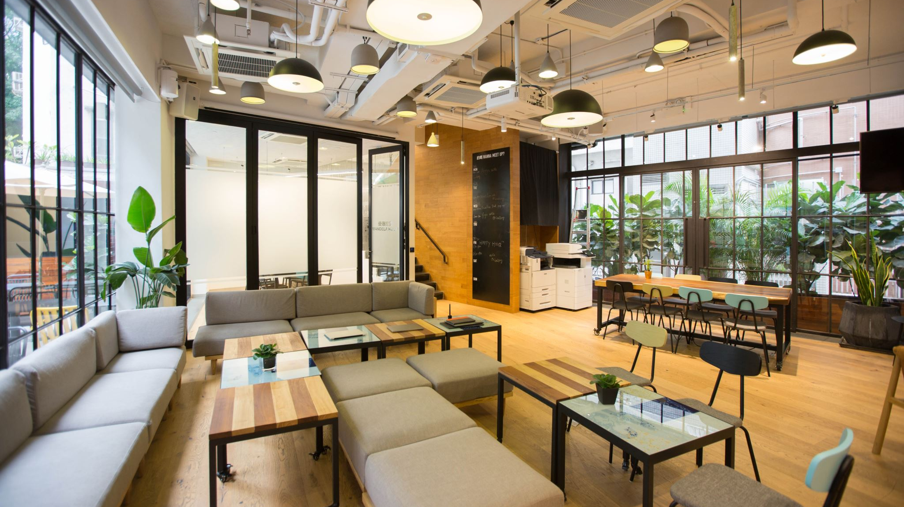
Objectives
The objectives of hostel management include providing safe and comfortable accommodation for residents.
Ensuring the security and well-being of residents.
Maintaining cleanliness and order in the hostel.
Managing and allocating resources efficiently.
Promoting a positive and supportive community atmosphere within the hostel.
Additionally, hostel management may also aim to generate revenue for the hostel and its owners through the renting of rooms and other facilities.

Slide 6

System Architecture
The system architecture of hostel management typically involves several key components, including:
Front-end: This is the interface that residents and other users interact with, such as a website or mobile app.
Database: This stores information about residents, rooms, and other resources. It is used to keep track of room allocations, reservations, and other important information.
Back-end: This is the server-side logic that handles the processing of information and interactions between the front-end and the database.
Payment gateway: This component handles transactions such as room bookings, payments, and refunds.
Reporting and analytics: This component generates reports and analytics that provide insight into the performance and usage of the hostel, such as occupancy rates and revenue.

Slide 7
Hardware & software requirements:
As the project is about creating a site to manage hostels/PGs provided for students,
Hardware requirement is null.
For software, we need a database to store client side and the tenant side data,
Knowledge of html, css, javascript and similar language in order to create & design the site
Login linking and payment linking are been done by a team simultaneously.

Slide 8
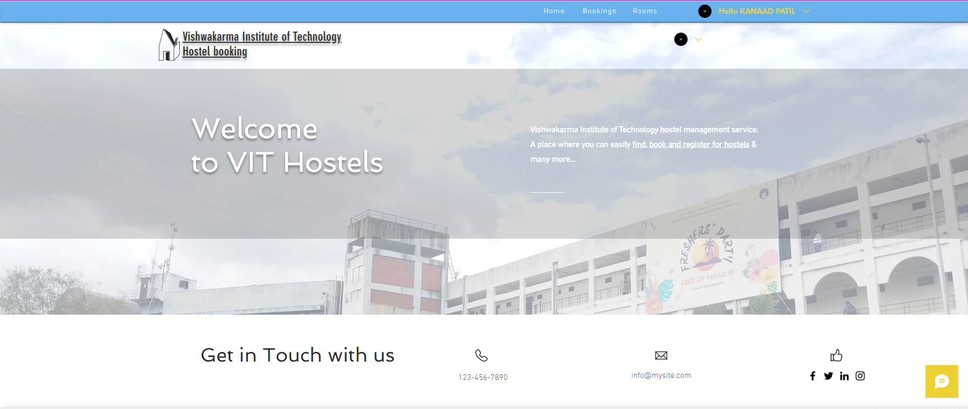
Demo:

Slide 9
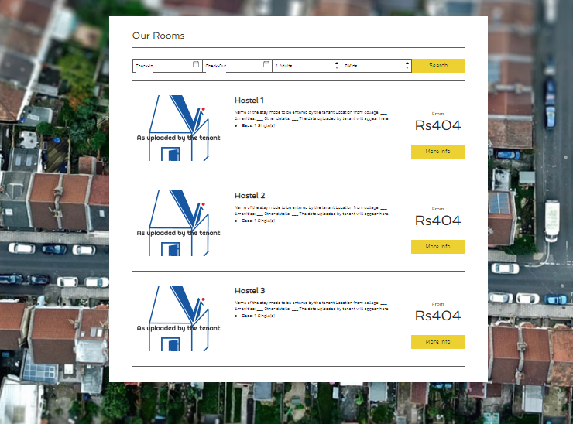

Slide 10

Conclusion:
Our project “HOSTEL MANAGEMENT SYSTEM” is a very helpful and important project that will manage various activities in the hostel like accommodation, rents, student records and many other things that are very useful for a well-managed hostel.
The scope of this project is to provide the facility of the living to the student of rural areas, who are unable to study further in their area.
They will be able to have an affordable rates of living in hostel and they will be fully provided the environment which they need for their studies.
Another benefit of this project is that all the hostel managing works can be done easily through it by saving our time and also by saving the human efforts.
This management system will be an errorless or bugs free management system and will be able to show the records of even years without any confliction.

Slide 11

Future Scope:
This hostel management software is designed for people who want to manage various activities in the hostel.this project is desined to fulfil thr need of future generations.
This project is small package which includes different categories as well as having all possible features.we have expected that it will be helpful for customers as well as administrative member.
We will improve this project in future in security by providing a coated card to permanent students for automatic check in and check out.

Slide 12

Advantages:
1.Your business is open around the clock.
2. You can maximize reservations. If a customer does need to cancel, the spot automatically opens online, giving another customer the chance to book it. By maximizing your reservations, you won’t leave unused activity spots or rentals on the table.
3. You get paid quicker.This puts money into your pocket faster and helps make sure that on the day of the event you don’t have to worry about payment
4.It is less time and effort consuming
5.It reduces the manual work of management
6.You can effortlessly up-sell add-ons. By adding additional perks to your customers, you can easily add extra revenue for your business. Fun extras like photo packages or memorabilia, you can include options to these items in your online booking checkout.

Slide 13

Disadvantages
You need Internet access. You’ll need reliable Internet access to check your reservations and to add bookings that are made online.
You need to be ready for an influx of new customers. Online booking software is a great way to attract new customers, many of whom prefer booking online from their computers and mobile devices. However, if you’re running a small operation without enough staff members or resources to expand your activities, growing too quickly may pose a challenge.

